Slide 1

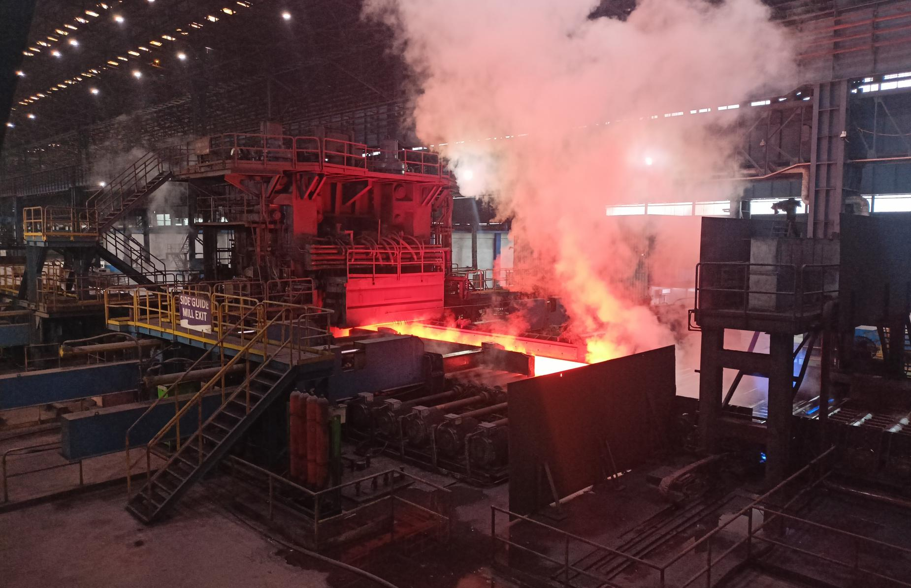

Project
Report
Name: Nannuri Pranay Kumar Reddy
Branch: Electrical Engineering
Department: DRI
College: Indian Institute of Technology BHU Varanasi

Slide 2

Page 02
Table of Contents
Preface
a
Company Overview
b
History
c
Research
d
Finding
e
Recommendations
f
Conclusion
g

Slide 3
Page 03
Preface
This report is the culmination of my internship experience at JSPL Raigarh, where I worked in the Direct Reduced Iron (DRI) department. During the initial weeks, I familiarized myself with the site, gaining insights into the operation of kilns, auxiliary machinery, and the overall process of sponge iron production. This hands-on exposure highlighted several areas where automation could be significantly improved.
Despite the use of Programmable Logic Controllers (PLCs) and computers, I observed that many critical tasks were still performed manually. These tasks included collecting vibration data for predictive maintenance, measuring temperatures at incomers Power Control Centers (PCC) and Motor Control Centers (MCC) to prevent overheating, and noting data from energy meters to monitor power consumption. Manual data collection is not only time-consuming but also prone to human error and inefficiencies, especially given the large cabling lengths required for connecting these meters.
To address this issue, I decided to focus on automating the data collection from energy meters. I researched industry communication protocols, particularly Modbus over RS485, and explored the potential of using wireless connectivity to streamline this process. My goal was to implement an IoT-based solution that would enable real-time data monitoring, accessible even when employees are offsite, through a single URL.
The proposed solution involves using WiFi-enabled devices, such as the ESP32, to connect to the RS485 terminals of power meters. The data is then transmitted over the internet to a cloud service like ThingSpeak, which provides a user-friendly interface for real-time data visualization. This approach not only aligns with Industry 3.0 standards but also paves the way for transitioning towards Industry 4.0.

Slide 4
Page 03
Throughout this report, I detail the development of a prototype, the challenges encountered, and the results achieved. The prototype includes an ESP32 microcontroller, a temperature sensor, and a sound sensor, demonstrating how data can be effectively collected and visualized on ThingSpeak. I also present a cost analysis comparing this solution to traditional methods and highlight the advantages and potential limitations.
This project showcases the feasibility of using IoT for industrial automation, emphasizing the importance of innovation in enhancing operational efficiency. I am grateful to the team at JSPL for their support and guidance, which were instrumental in the successful completion of this project. I hope that the findings and recommendations presented in this report will contribute to further advancements in automation within the DRI department and beyond.

Slide 5

Page 04
Company Overview
About JSP
About JSP Angul
Borcelle Agency is a full-service digital agency established in 2002. With a passion for crafting engaging online experiences, we’ve successfully served clients across diverse industries, helping them achieve their digital goals.
Our mission is to empower businesses with innovative digital marketing solutions that drive sustainable growth
Future of JSP Angul
Our vision is to become a globally recognized leader in digital marketing, renowned for our creativity, expertise, and unwavering commitment to our clients' success
2023

Slide 6
Page 05
History
Origin
Mention the history and origin of the technologies and output that you are working on. 80-100 words
Current Developmental status
Mention the current status and improvements in the technologies and output that are coming up.

Slide 7
Page 06
Research
Research undertaken by you + Methodologies employed. Utilise a maximum of 5-6 pages.

Slide 8
Research
ABCD
2023

Slide 9
Research
ABCD
2023

Slide 10
Research
ABCD
2023

Slide 11
Research
ABCD
2023

Slide 12
Research
ABCD
2023

Slide 13
Page 08
Findings
Categorize and describe your findings
XYZ
Sub heading
Brief description
ABC
Sub heading
Brief description
MNO
Sub heading
Brief description
2023

Slide 14
Page 08
Findings
Categorize and describe your findings
XYZ
Sub heading
Brief description
ABC
Sub heading
Brief description
MNO
Sub heading
Brief description
2023

Slide 15

Page
Conclusion / Recommendations
Describe as brief pointers
ABC
MNO
XYZ
PQR
STU
DEF
2023

